Slide 1
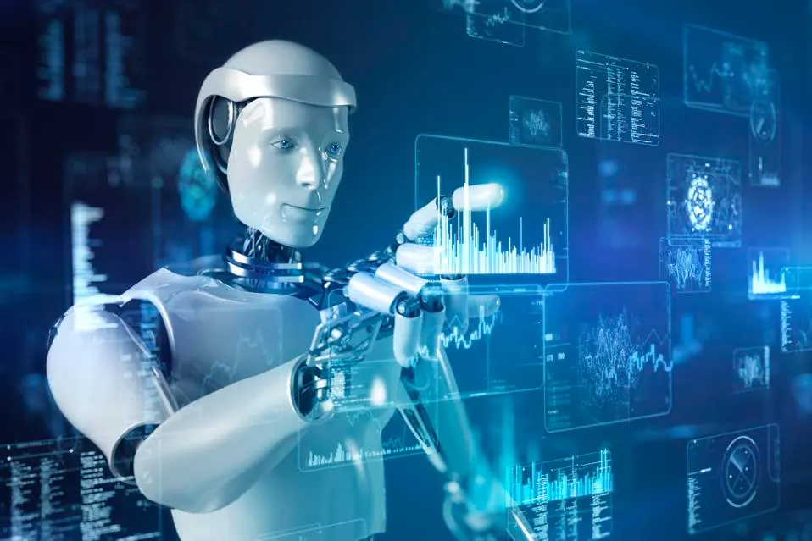


Slide 2
What Is AI?
Artificial intelligence (AI) is intelligence demonstrated by machines, as opposed to intelligence displayed by humans or by other animals. "Intelligence" encompasses the ability to learn and to reason, to generalize, and to infer meaning. Example tasks in which this is done include speech recognition, computer vision, translation between (natural) languages, as well as other mappings of inputs. Artificial intelligence allows us to generate content, take decisions and perform predictions automatically without the need for human in the process.

Slide 3
Where We Can Find AI In The Industry?
AI is becoming a crucial part in almost every industry and especially in the high tech companies. AI can be used in order to:
Automate repetitive tasks
Analyze large amounts of data
Enhance decision-making processes
Develop new medical treatments
Improve customer service
Enhance natural language processing
Create self-driving vehicles
Assist in disaster response and prediction

Slide 4
The Evolution Of AI
As almost any new invention or technology that was developed by the industry, AI main goal is also to make money for the organizations that use it. So in order to understand how AI can save and generate additional income to the company we need to understand what are the problems the AI meant the solve in the first place. Data analysis → the process of inspecting, cleaning, transforming, and modeling data with the goal of discovering useful information, informing conclusions, and supporting decision-making.
Data analysis became more and more important as the organizations managed to save and gather more and more data from their customers.

Slide 5
The Evolution Of AI
Most companies are hiring Data analysts in order to manually perform the tasks of managing and organizing the data, explore the data and get insights from the data that will help the company perform better.
BI Development → Business intelligence (BI) comprises the strategies and technologies used by enterprises for the data analysis and management of business information. Common functions of business intelligence technologies include reporting, online analytical processing, analytics and dashboard development.

Slide 6
The Evolution Of AI
BI tools can handle large amounts of structured and sometimes unstructured data to help identify, develop, and otherwise create new strategic business opportunities. They aim to allow for the easy interpretation of these big data. Identifying new opportunities and implementing an effective strategy based on insights can provide businesses with a competitive market advantage and long-term stability, and help them take strategic decisions.
Most companies are hiring BI Developers in order to create and develop data reports and dashboards using modern BI tools such as: PowerBI, Tableau, Qlick, etc… In order to become BI Developer you need to control SQL, Excel and Some BI tools.

Slide 7
The Evolution Of AI
As the technology kept to evolve in addition the ways companies collect handle and organized their massive data, the data analysis world evolved as well.
Machine Learning → Machine learning (ML) is a field devoted to understanding and building methods that let machines "learn" – that is, methods that leverage data to improve computer performance on some set of tasks. Machine learning algorithms build a model based on sample data, known as training data, in order to make predictions or decisions without being explicitly programmed to do so.
Machine learning algorithms can be separated to supervised learning algorithms & unsupervised learning algorithms.

Slide 8
The Evolution Of AI
Data Scientist → Data scientists in companies are responsible on the machine learning process. They responsible on choosing the right algorithm in order to perform the required task. The Data scientist also responsible on coding the algorithm so the machine could learn.
In addition he responsible on the deployment process and perform QA during the machine learning process.
Generative AI → generative AI is a type of artificial intelligence system capable of generating text, images, or other media in response to prompts. Generative AI models learn the patterns and structure of their input training data, and then generate new data that has similar characteristics.

Slide 9
The Evolution Of AI
Notable generative AI systems include ChatGPT (and its variant Bing Chat), a chatbot built by OpenAI using their GPT-3, GPT-4 and Bard, a chatbot built by Google Other generative AI models include artificial intelligence art systems such as Stable Diffusion, Midjourney, and DALL-E.
AI represent the latest step in the data evolution, The machine will teach itself using existing data and previous learning processes. The machine itself will choose the right algorithm to learn and perform the required task the best way possible. In addition the machine will be able to correct itself and improve its results.

Slide 10
The Evolution Of AI
AI Developer / AI Engineer → AI Developer is responsible to use existing AI tools and AI algorithms and combine them in the company products and tools. AI developer needs to understand both in the Data Science field (machine learning algorithms, AI algorithms and data analysis) and also in the Computer Science field (Web development, API, Data Structure)
This course purpose is to qualify AI developers meaning you will learn both the Data Science and the Computer science fields.

Slide 11
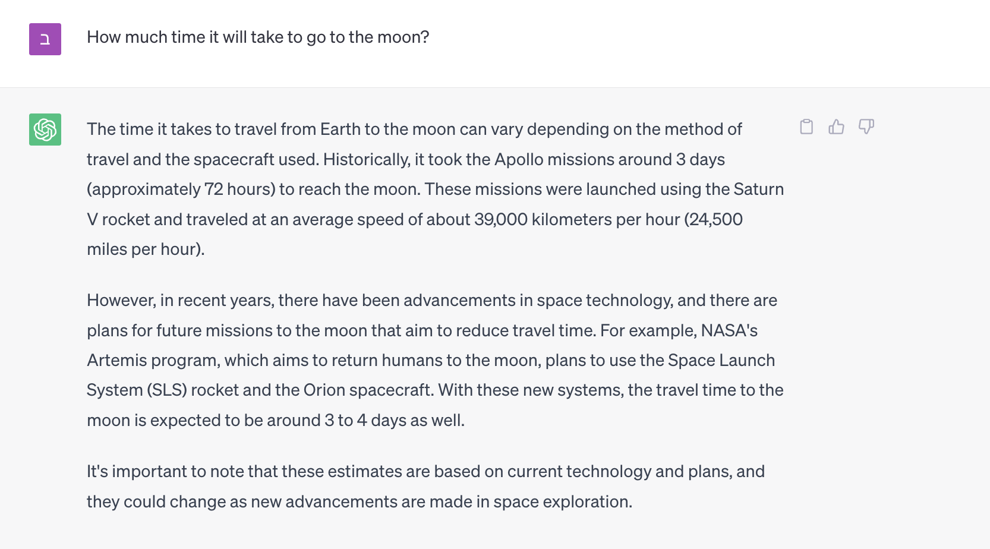
Most Common Gen-AI Tools
Chat GPT → ChatGPT is an artificial intelligence chatbot developed by OpenAI and launched on November 30, 2022. It is notable for enabling users to refine and steer a conversation towards a desired length, format, style, level of detail, and language used. Successive prompts and replies are taken into account at each stage of the conversation as a context.

Slide 12
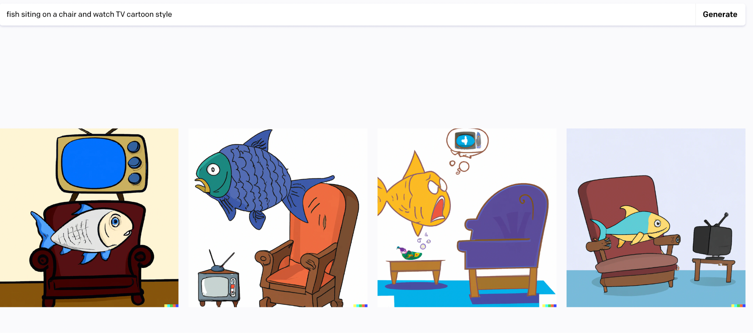
Most Common Gen-AI Tools
DALL-E → DALL-E and DALL-E 2 are deep learning models developed by OpenAI to generate digital images from natural language descriptions, called "prompts".

Slide 13

Most Common Gen-AI Tools
SoundRaw → SoundRaw is a generative AI tool that allow users to generate music and sounds by providing prompts such as the mood, genre and theme.

Slide 14
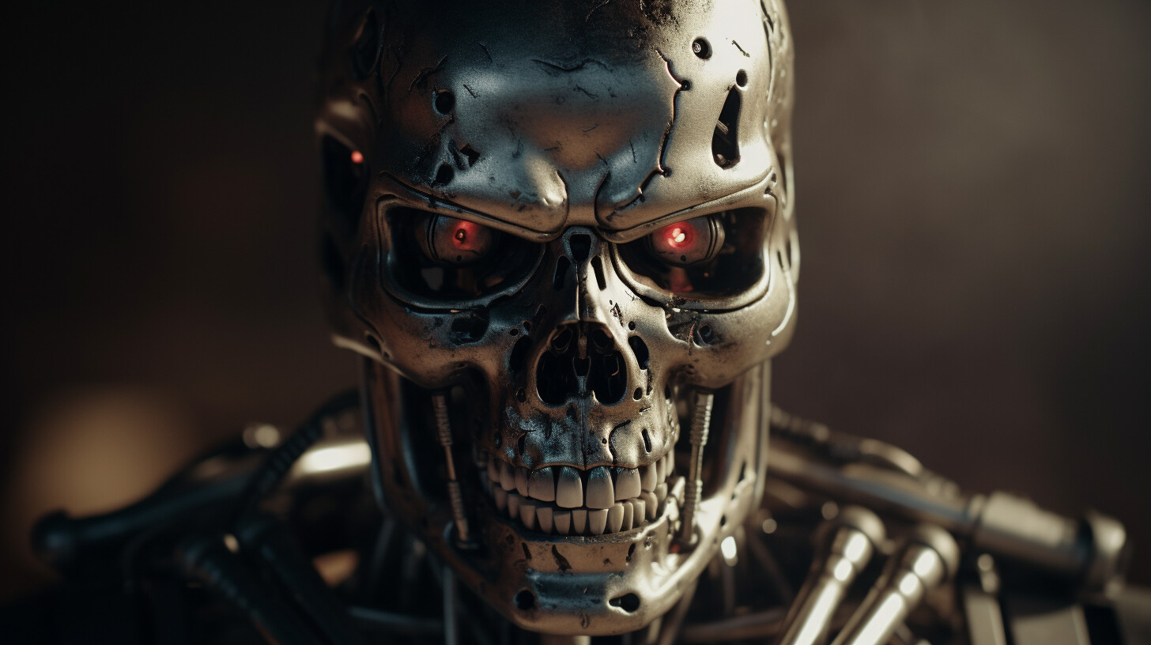
The Dangers With AI Revolution

Slide 15
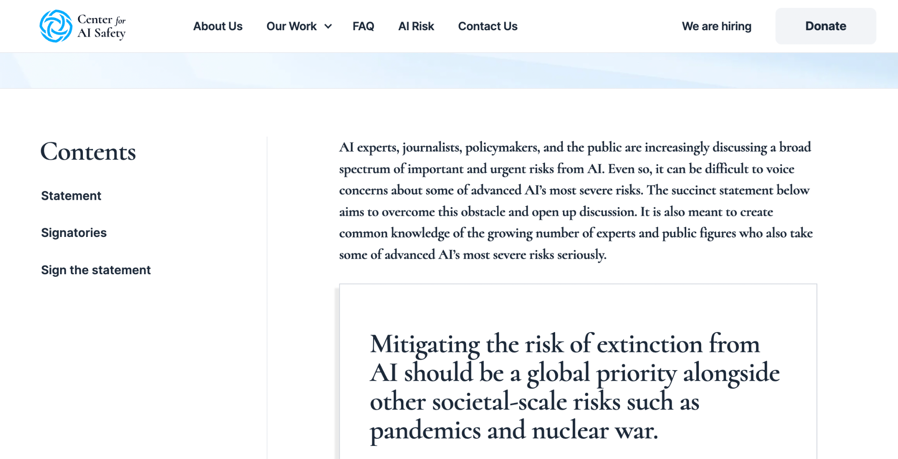
The Dangers With AI Revolution
We all understand the benefits humanity will gain from the coming AI revolution but it is also important to understand the dangers and risks we can experience with this revolution.

Slide 16
The Dangers With AI Revolution
Credibility Issues → AI can generate text and information that can look for humans very realistic and based on fact but in fact it can be complete fiction and made up information that not really exists. That can cause a lot of problems in determine what is real fact and what is not.
Fake News → AI can be used to generate or spread fake news, contributing to the misinformation landscape and threatening the integrity of information sources, leading to societal divisions and undermining trust in institutions. Fake news can be news reports that are not exists, pictures, videos and sounds records that are all fake.

Slide 17
The Dangers With AI Revolution
Bias Issues (Profiling) → AI systems often learn biases present in the data they are trained on, which can perpetuate and even amplify existing stereotypes and prejudice, leading to unfair treatment, discrimination, and profiling in areas such as facial recognition, criminal justice, and hiring practices. For example: if you will ask AI how loyar should look like it will tell you it's an old white man.
Job loss → There are concerns that AI and automation will lead to significant job displacement, In average 3 out of 4 people in USA think that their jobs are in risk because of the AI revolution. Massive job loss can bring our social welfare systems to collapse.

Slide 18
The Dangers With AI Revolution
Intimacy issues → AI-enabled devices can infringe on privacy rights and create feelings of isolation when people rely on AI-driven technologies for emotional support or companionship, undermining genuine human connections. The movie “Her” predict this scenario perfectly, in the movie a man is falling in love with his computer operating system.
Technology Misused → AI can be used by malicious actors, including criminals, hackers, or even oppressive governments, for surveillance, disinformation campaigns, cyberattacks, and other nefarious activities, posing threats to individuals and nations alike.

Slide 19
The Dangers With AI Revolution
Autonomous weapons → There is a growing concern about the development of AI-powered weapons, including drones and autonomous robotic weapons systems, which could make life-and-death decisions without human intervention, raising ethical and legal questions and potentially triggering unforeseen conflicts or arms races.
AI surpassing human control → One of the more catastrophic scenarios is that AI might become too intelligent, leading to a loss of human control over these systems. This would result in AI entities making decisions without human input, potentially causing harm or furthering their own objectives at the expense of human interests and values.

Slide 20
What can we do to mitigate those AI dangers?
To mitigate the dangers associated with AI, several steps can be taken to promote responsible AI development and usage:
Develop ethical guidelines → Establish ethical principles or guidelines for AI development and deployment, considering issues such as human rights, fairness, transparency, accountability, and safety.
Increase transparency → Encourage AI developers to disclose information about their algorithms, data sources, and intended impacts, allowing for better understanding and scrutiny of AI systems.

Slide 21
The Dangers With AI Revolution
Create regulations and policies → Develop and enforce legal frameworks that ensure AI technologies are used transparently, fairly, and in a manner that respects privacy and security.
Invest in AI education and awareness → Promote AI literacy among the public and policymakers, enabling them to make informed decisions about AI implementations.
Implement fairness and unbiased algorithm development → Ensure developers focus on designing AI systems that are unbiased and address fairness issues in data and algorithms.

Slide 22
The Dangers With AI Revolution
Establish AI safety standards → Develop industry-wide safety standards for AI development, testing, and deployment, ensuring the technology's responsible and safe use.
Encourage corporate responsibility → Promote corporate engagement in responsible AI practices, holding businesses accountable for the consequences of their AI systems, and prioritizing ethical considerations as part of their corporate strategy.

Slide 23

Q&A

